Slide 1
Art of the Possible
Workshop
Arming you with the mindset, methodology,
tools, and resources to successfully and securely scale your organization’s mission.

Slide 2
Our transformation
mission
The future is more than cloud, software, and tools. It requires an
organization-wide shift in mindset, culture, and ways of working.
It’s a commitment to transform from within.
As agents of change and transformation, we will empower you to drive your
organization’s unique innovation and modernization strategy effectively,
so you can adopt and sustain future ways of working as smoothly as
possible, achieving faster time to value.

Slide 3
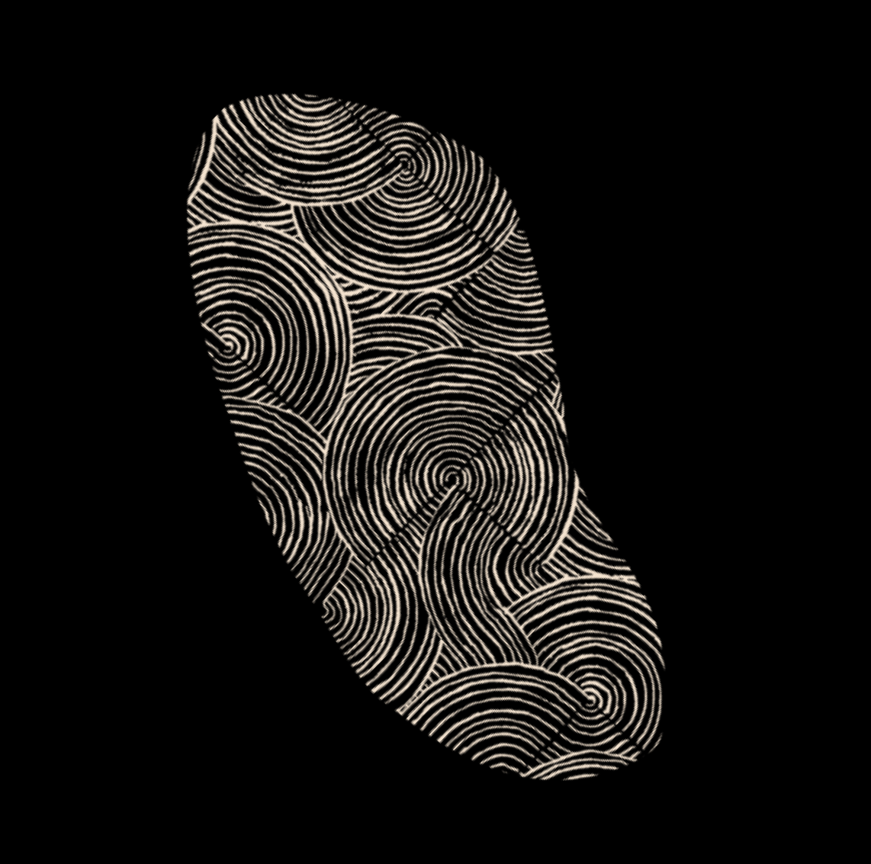
Change vision
We’ll collaborate with you to understand the current state of your organization, work to
understand your objectives, and help define what transformation looks like for you. We will craft a narrative, provide a roadmap, articulate the benefits, and drive transparency as leadership discusses the importance of this transformation in your business.
Current State Art of the Possible Roadmap Deliverable Assessment Workshop and Tracking Tool

Slide 4
How we assemble
your dream team
When it comes to transformation, we feel you.
Many of us have been in your shoes as clients
and have previous experience in your industry.
You can count on us to dive deep into unexpected
situations and emerge victorious— because we’re
stronger together.
We are a team of change specialists, leaders, architects, communicators, and problem solvers.
Contact us!
If you are interested in learning more about
how Infused Innovations can drive innovation and modernization in your organization, reach out for a conversation!
Contact us:
info@infusedinnovations.com
www.infusedinnovations.com

